Slide 1
Welcome Back to Mendelian Randomization
Some questions for reviewing what we have learnt:
What are the three basic principles lying in MR?
What is the advantages of MR when compared to traditional association studies in epidemiology?
What is the biggest challenge in performing MR?
How to detect the pleiotropy of IVs in MR analysis?
Please retell the flow chart of writing a MR paper systematically.

Slide 2
Today my speech can be divided into three parts
A brief introduction to the correction of statistical hypothesis test as a supplementary to the last speech.
An explanation to UK Biobank’s phenotypes and explain how to get your idea from it.
A discussion of my unpublished MR paper for your reference.

Slide 3
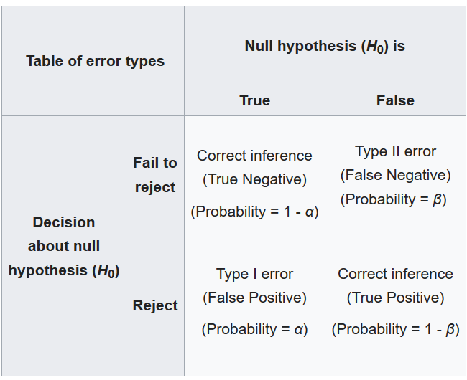

Slide 4
A type I error (or error of the first kind) is the incorrect rejection of a true null hypothesis. Usually a type I error leads one to conclude that a supposed effect or relationship exists when in fact it doesn't. Examples of type I errors include a test that shows a patient to have a disease when in fact the patient does not have the disease, a fire alarm going on indicating a fire when in fact there is no fire, or an experiment indicating that a medical treatment should cure a disease when in fact it does not.

Slide 5
A type II error (or error of the second kind) is the failure to reject a false null hypothesis. Examples of type II errors would be a blood test failing to detect the disease it was designed to detect, in a patient who really has the disease; a fire breaking out and the fire alarm does not ring; or a clinical trial of a medical treatment failing to show that the treatment works when really it does.

Slide 6
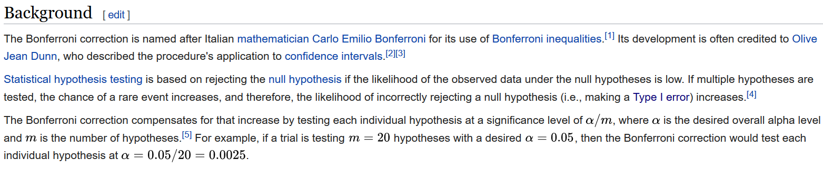
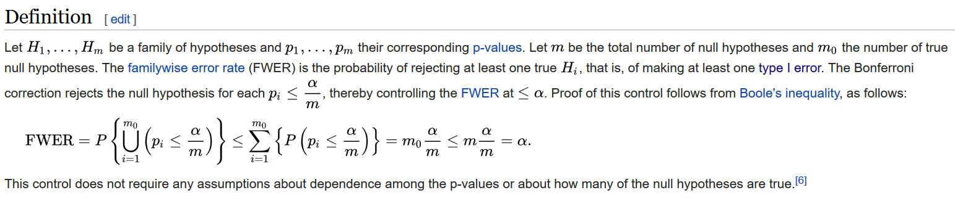

Slide 7
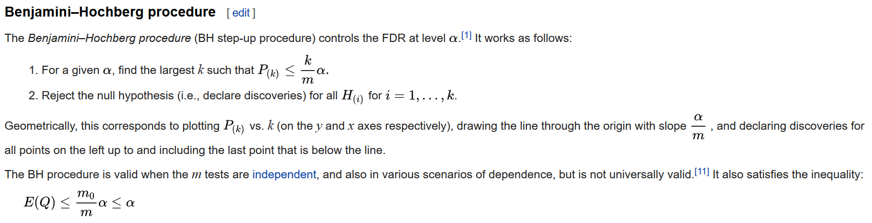

Slide 8
Could you explain why Bonferroni correction is much stricter than FDR? Please demonstrate an example for your explanation

Slide 9
If the original P value is 0.05 and the number of tests is 10,000, then in the Bonferroni correction, the corrected threshold is equal to 5% / 10000 = 0.000005, and all P values exceeding 0.00005 are considered to be unreliable. In this case, the number of false positive results in 10,000 tests is 10000 * 0.000005 = 0.5, less than one time.
Bonferroni correction
If we performed 10,000 tests in the initial setting. This time we set FDR<0.05. If our test subjects are differentially expressed genes, then if we have 500 genes in 10,000 tests. Then, the false positive results in these 500 genes are less than 500*5% = 25 .
FDR correction

Slide 10
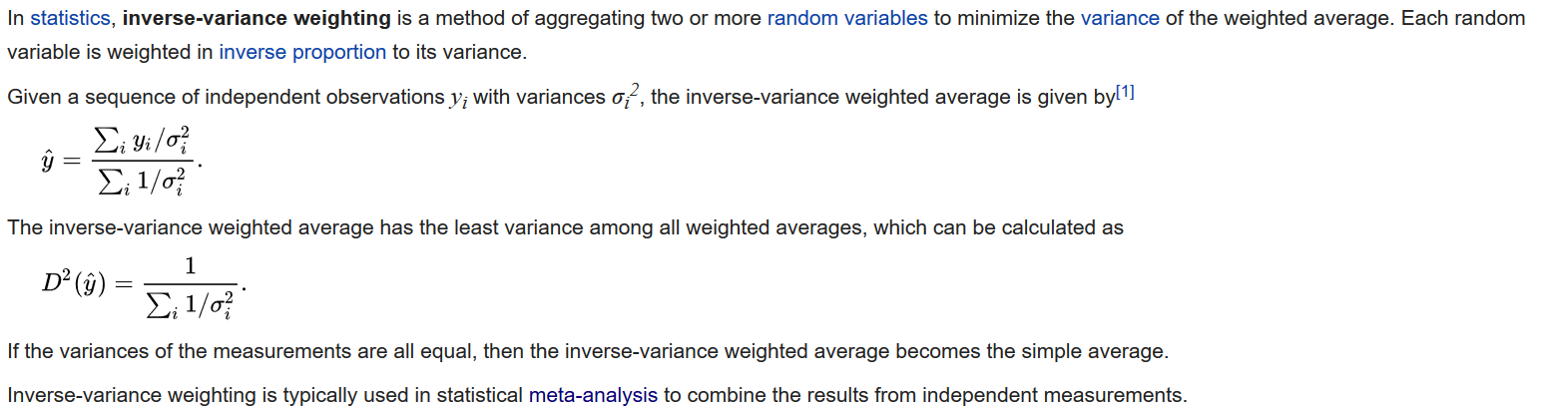
Inverse Variance Weighted (IVW) method

Slide 11
SNP | beta.exposure | se.exposure | pval.exposure | beta.outcome | se.outcome | pval.outcome
rs10840017 | -0.01003 | 0.001757 | 1.14E-08 | -0.00152 | 0.001318 | 0.250369
rs10875622 | 0.009793 | 0.001458 | 1.89E-11 | -0.00177 | 0.001094 | 0.10485
rs11125776 | -0.01464 | 0.002049 | 8.96E-13 | -0.0045 | 0.001538 | 0.003414
rs11138082 | 0.014158 | 0.001785 | 2.19E-15 | 0.000874 | 0.00134 | 0.514106

Slide 12
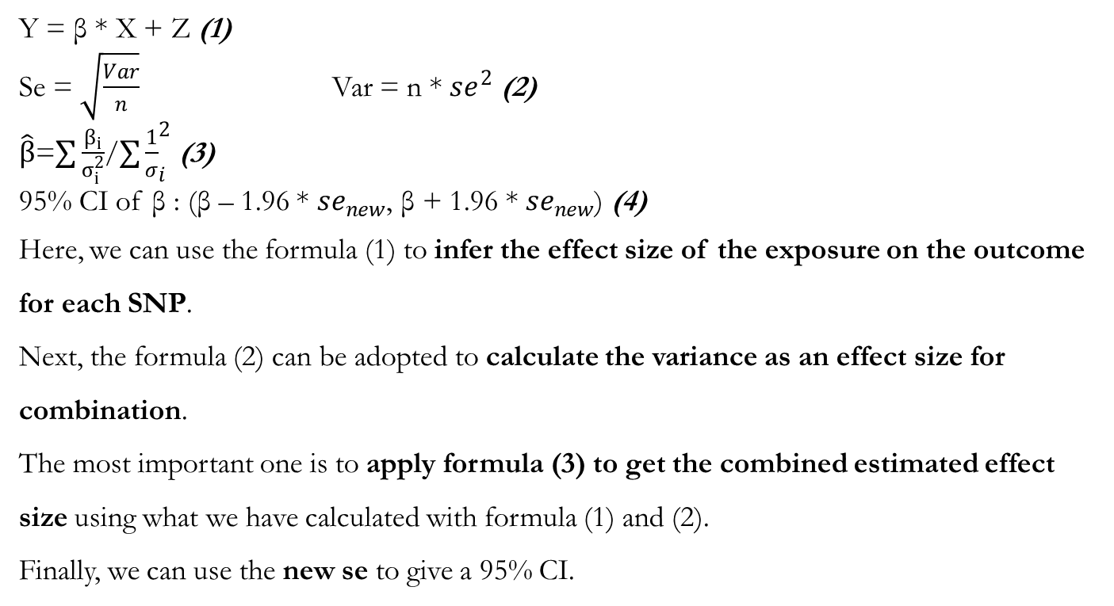
Y = β * X + Z (1)
Se = $\sqrt{\frac{Var}{n}}$ Var = n * ${se}^{2}$ (2)
$\hat{β}$=$∑\frac{β_{i}}{σ_{i}^{2}}$/$∑{\frac{1}{σ}}_{i}^{2}$ (3)
95% CI of β : (β – 1.96 * ${se}_{new}$, β + 1.96 * ${se}_{new}$) (4)
Here, we can use the formula (1) to infer the effect size of the exposure on the outcome for each SNP.
Next, the formula (2) can be adopted to calculate the variance as an effect size for combination.
The most important one is to apply formula (3) to get the combined estimated effect size using what we have calculated with formula (1) and (2).
Finally, we can use the new se to give a 95% CI.

Slide 13
Two Tips for Your Further Learning
1. Please take a look at MR Egger regression method and weighted median method.
2. Such methods are the core of meta-analysis as well.

Slide 14
How can you get the idea for MR?
If you find contradictory conclusions in different papers, try a MR to elucidate the actual relationship
If you have no idea, please refer to UKBB phenotype sheet and find what you are interested in
Now I am going to give a detailed explanation to UKBB phenotypes.

Slide 15
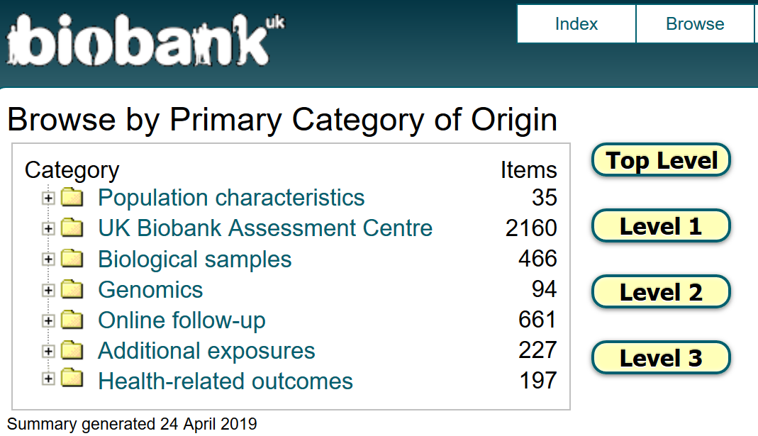

Slide 16
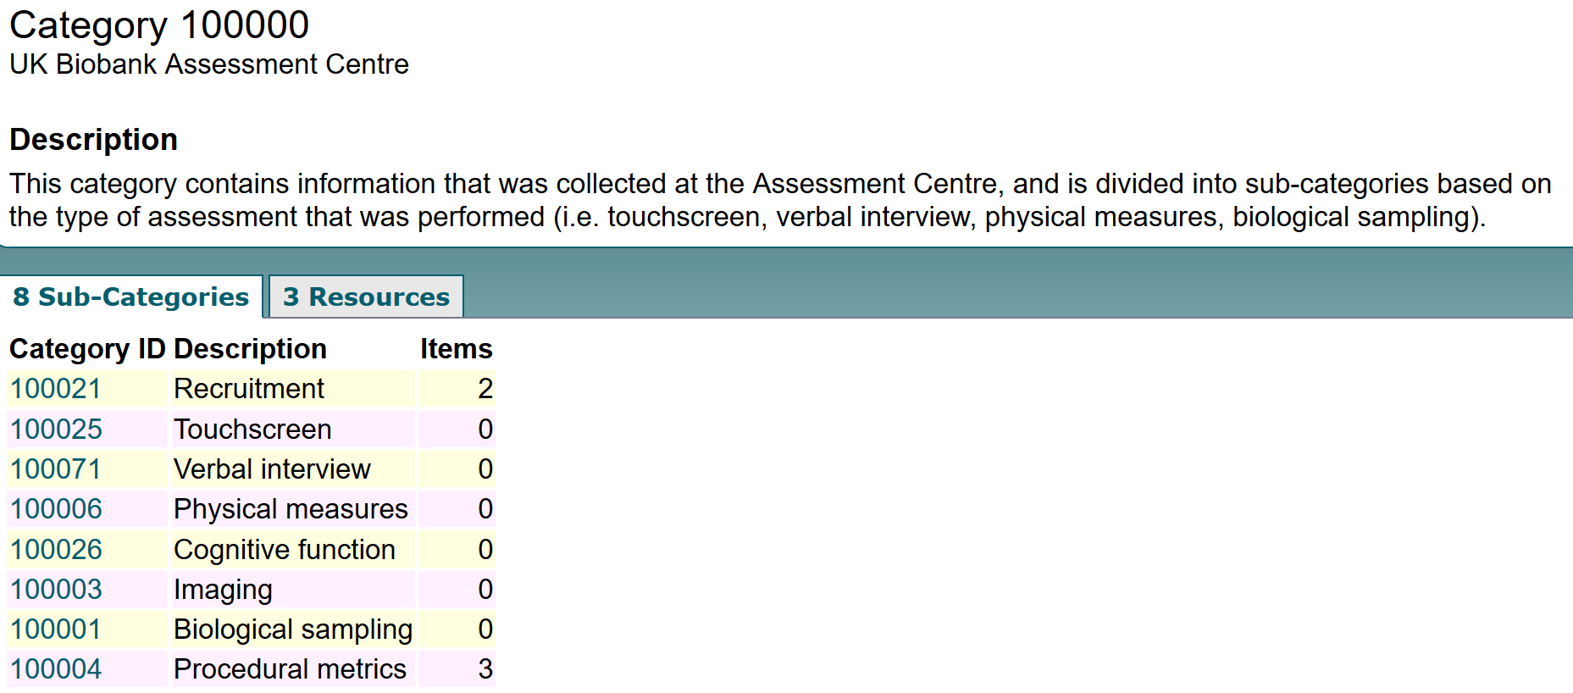

Slide 17
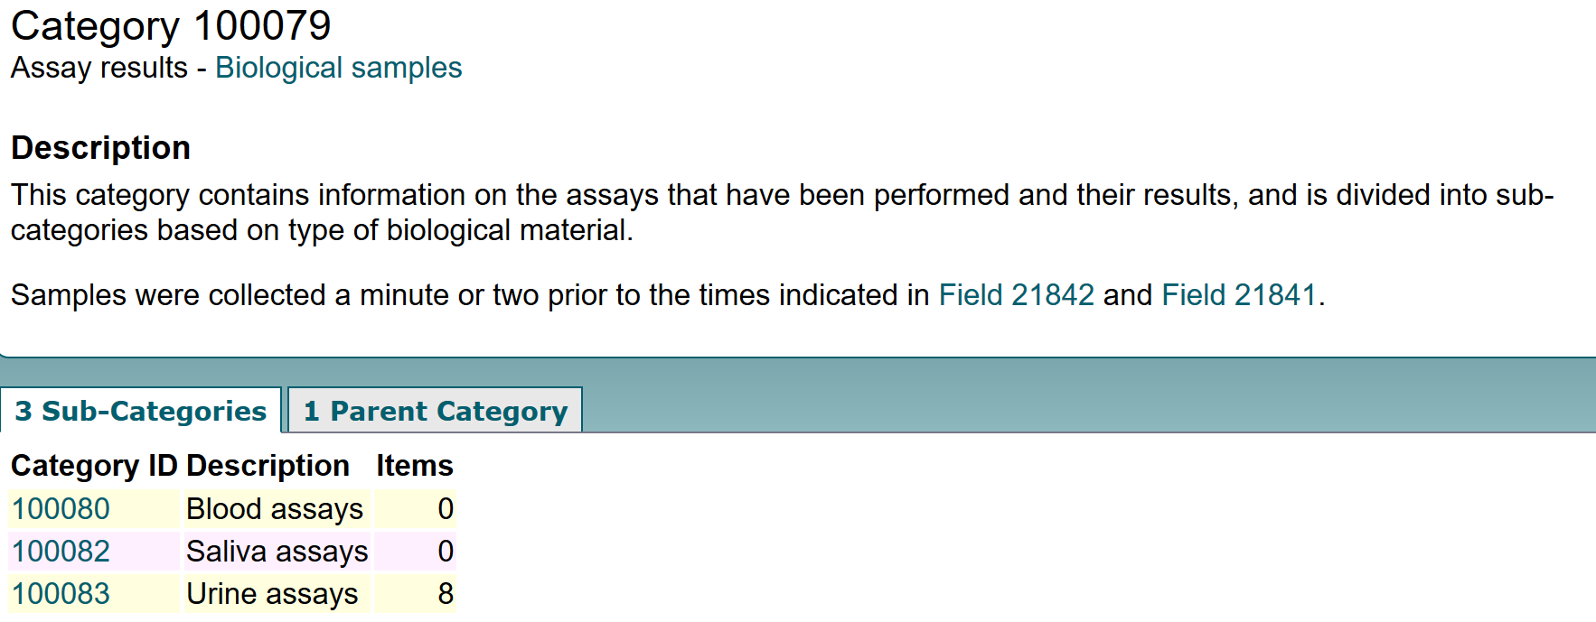

Slide 18
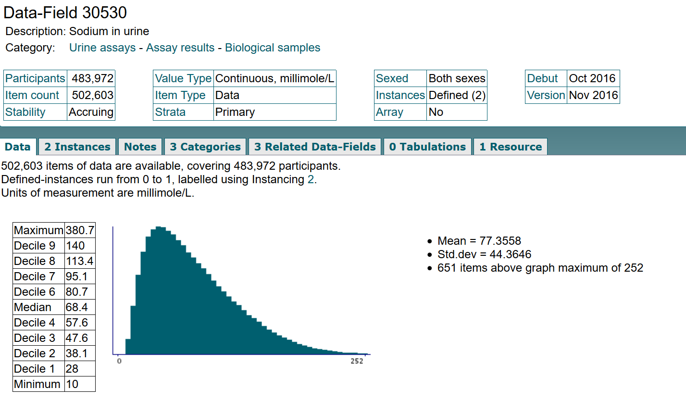

Slide 19
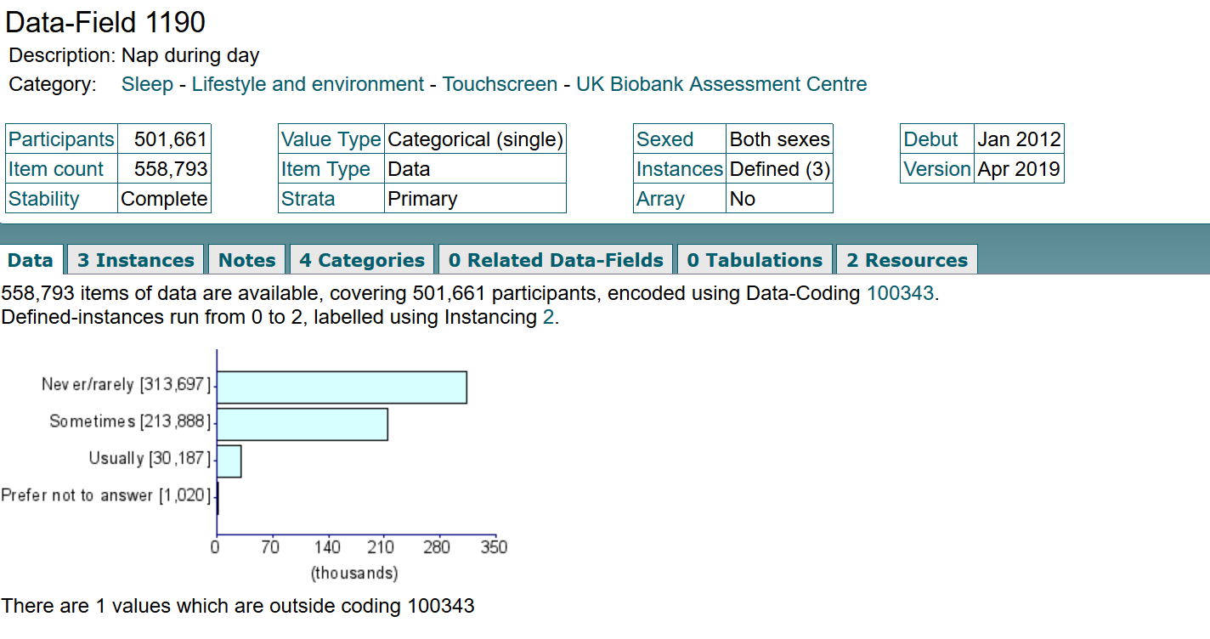

Slide 20
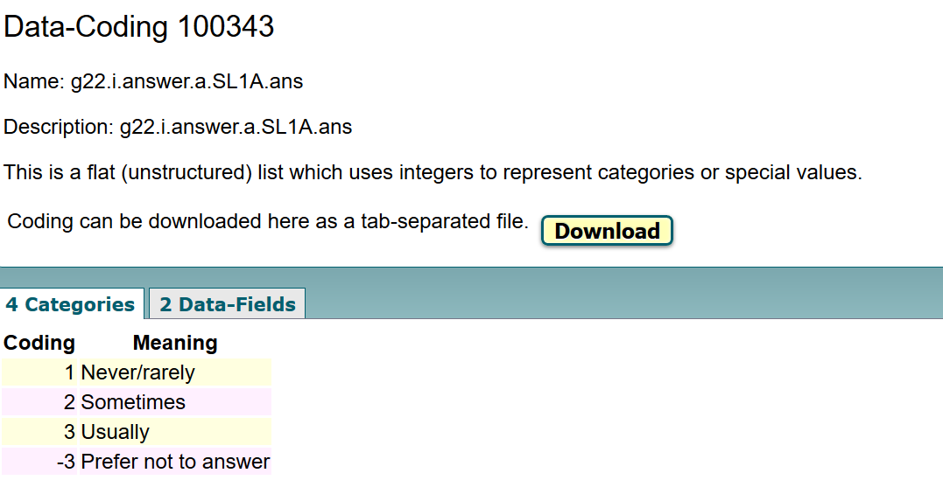

Slide 21
Please pay great attention to the phenotypes in our UKBB GWAS sheet

Slide 22
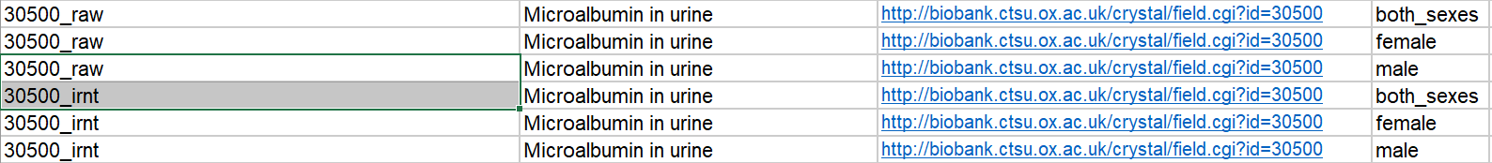
‘raw’ means ‘raw data’ (have a definite clinical meaning)
‘irnt’ means ‘inversed rank normalization’ (normalized data, stable but no specific clinical meaning)

Slide 23
It is better off studying a phenotype set at one time and we can not only explore the relationship between the exposure and outcome, but unveil the relationship among exposures.
Let’s take the sleep-related phenotype set as an example.
If we study only one exposure, we will know whether this exposure could result in other phenotypes but fail to find whether such causal relationship can be lead to by similar exposures.
In addition, a phenotype set study can explore the interplay among similar phenotypes.

Slide 24
Now I will introduce some interesting and meaningful
fields for you
Sample assay results（blood, saliva, urine)
Certain ophthalmology-related traits
Nutrient intake (vitamin, essential ions)
Diet ( vegetables, fruits, meat, meat and so on)
Lifestyles (sleep-related traits, sports-related traits and so on)
Disease-related symptoms (gastritis, rheumatoid arthritis, cardiovascular disease, neurodegenerative diseases)
Metabolism-related traits and diseases (blood pressure, urate concentration, diabetes, obesity and so on)
Psychiatry-related traits (anxiety, depression, schizophrenia and so on)
Anthropometry-related traits (BMI, height, weight, hip-waist ratio, body fat percentage and so on)

Slide 25
Essential preparations for writing a MR paper
1. Before running a certain phenotype set, you ought to search to make sure its feasibility.
2. Before writing, you are supposed to do a lot of research and find the meaningful points worth writing. Pay great attention to reviews.
3. Please remember that our high throughput analysis is able to produce a lot of results but you only need to select what you think is of great value

Slide 26
Thank you for your listening!

